Slide 1

Cognitive Labs Gary Wilson CTO & Technical Leader, UKI Commercial Business
Notes:
- LEARN:
- Build 2 applications using 5 Watson Cognitive services
- Conversation, Discovery, NLU, Visual Recognition, Language Translation
- All built using Node-RED, with minimal coding
- BUILD:
- GDPR Advisor chatbot
- Insurance Claims app
- Build your own basic prototype

Slide 2




What are we going to do?
Notes:
- LEARN & BUILD:
- Build 4 applications using 6 Watson Cognitive services via IBM Cloud
- All built using Node-RED, with minimal coding
- BUILD:
- Mobile Phone Advisor chatbot
- Drone Inspection simulator
- Cognitive Text Analyser
- Twitter Auto-Language Translator

Slide 3
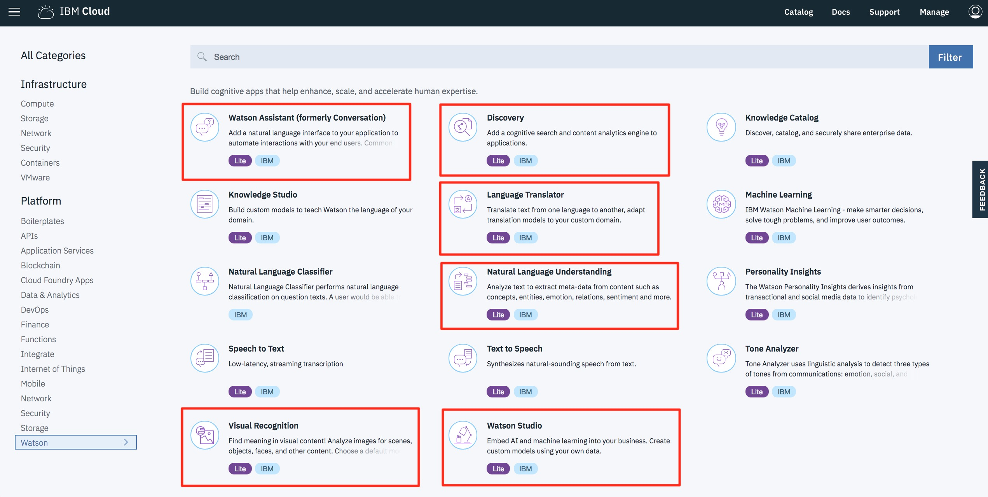
Watson Services on IBM Cloud
Notes:
- Watson Assistant, Discovery, NLU, Visual Recognition, Watson Studio, Language Translation

Slide 4
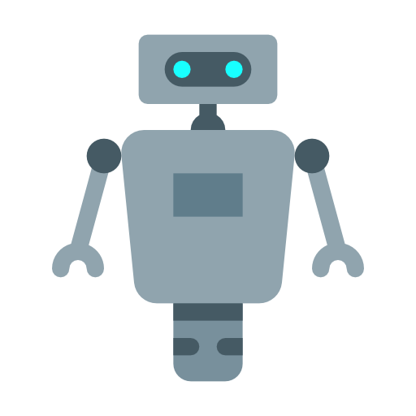
Cognitive chatbot
“I’d like advice on a new phone”
“How many times can I install an application I've purchased on the Market?”
“I’m interested in a new contract”
“My LG D800 is grinding to a halt, what can I do?”
”Here’s my review of the Galaxy S8”
Notes:
- Cognitive Lab 1 will have you working on building a CHATBOT
- By the end of the lab your chatbot should:
- work using a number of different UIs
- use Watson Assistant to answer BASIC questions to
help find a new mobile phone and contract for a user
- use Watson NLU to grade the SENTIMENT of a review you
can submit about a phone
- use Watson Discovery to answer more SPECIFIC
'support' type questions
- provide the most APPROPRIATE RESPONSE from these
services based on a confidence level

Slide 5


Chatbot: Question Distribution
Watson
Assistant
Here Watson uses reasoning strategies that focus on the language and context of the question.
How do I get a Visa?
I need to visit Zimbabwe as a British citizen with a criminal record—can I do that?
Frequency of Questions
Watson Discovery
Here Watson uses reasoning strategies that focus on identifying the most appropriate answer.
Short Tail
Long Tail
100s
100,000+
Unique Intents
Notes:
- We will use Watson Assistant and Watson Discovery to
answer both short-tail and long-tail questions
- Short-tail questions are typically more PREDICTABLE and
FREQUENT, and will be dealt with by Assistant
- Long-tail questions are typically more SPECIFC, and
retrieved from a KNOWLEDGE BASE, which we will do here
with Discovery

Slide 6
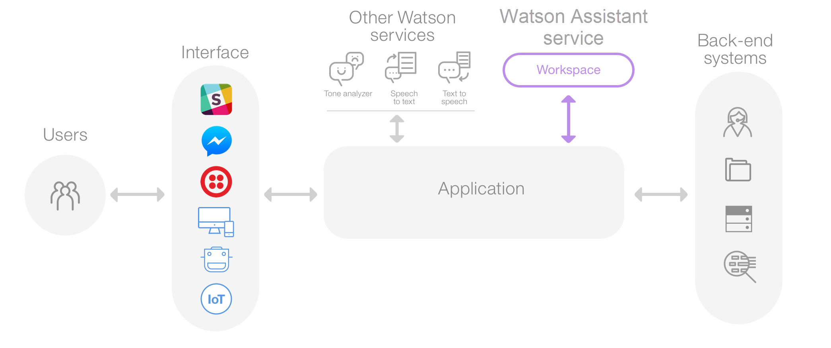

Cognitive Chatbot – common architecture
Watson Discovery
Watson NLU
Notes:
- This is a common Watson Assistant architecture
- Application can use multiple UIs
- FLOW is controlled by Watson Assistant
- INTERFACES to back-end systems when required
- We'll utilise this architecture, using:
- Node-RED for our application,
- HTML, Slack and Telegram as our UIs, and
- Discovery and NLU to enhance our bot

Slide 7
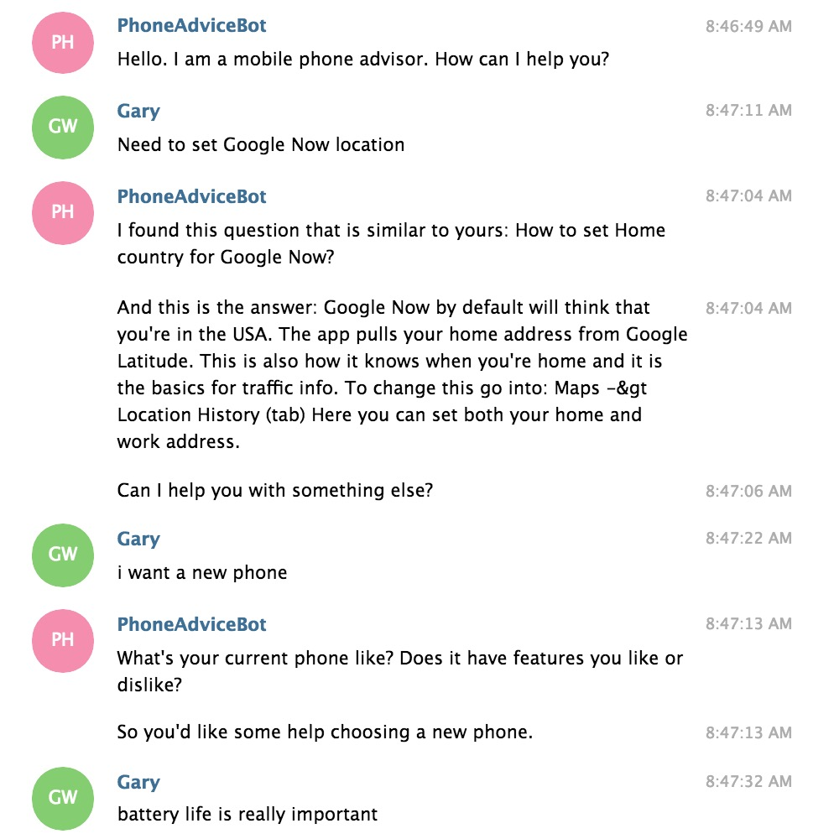
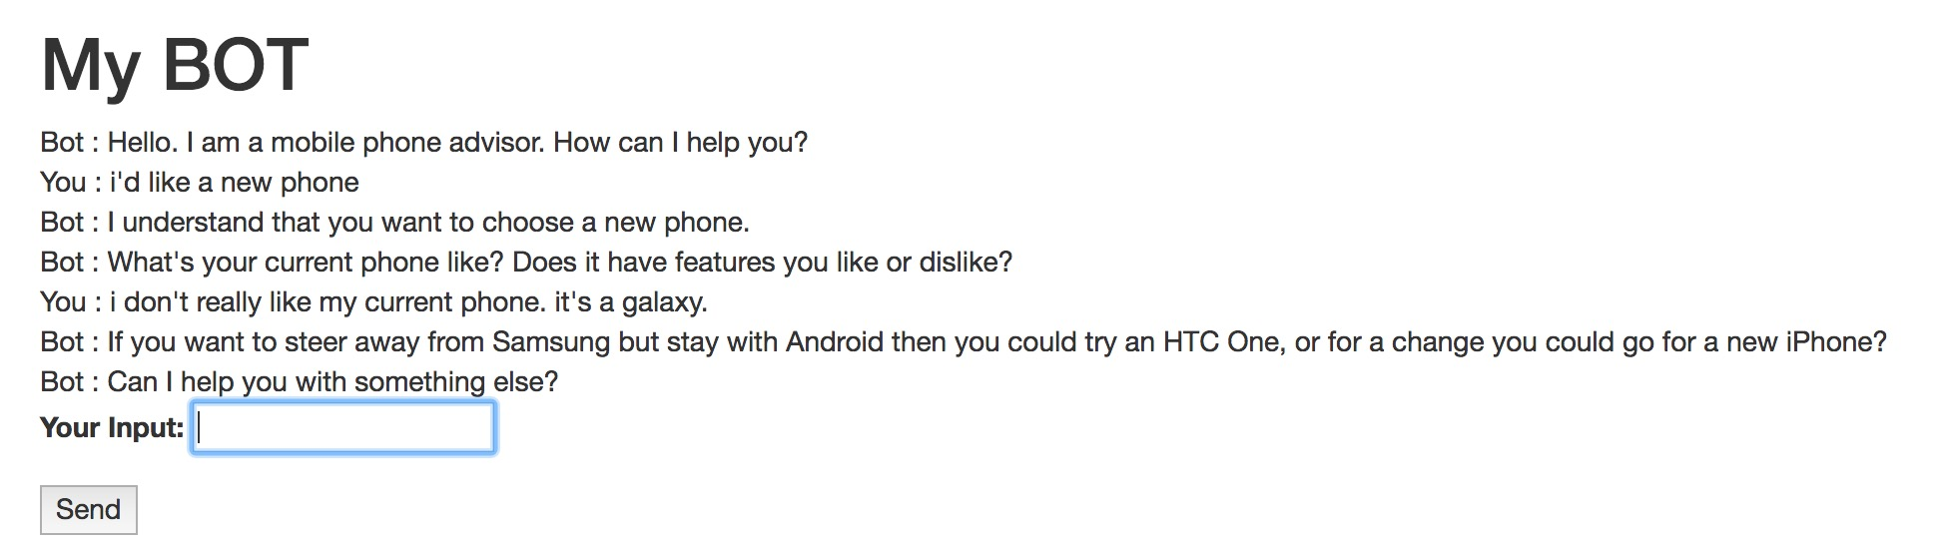
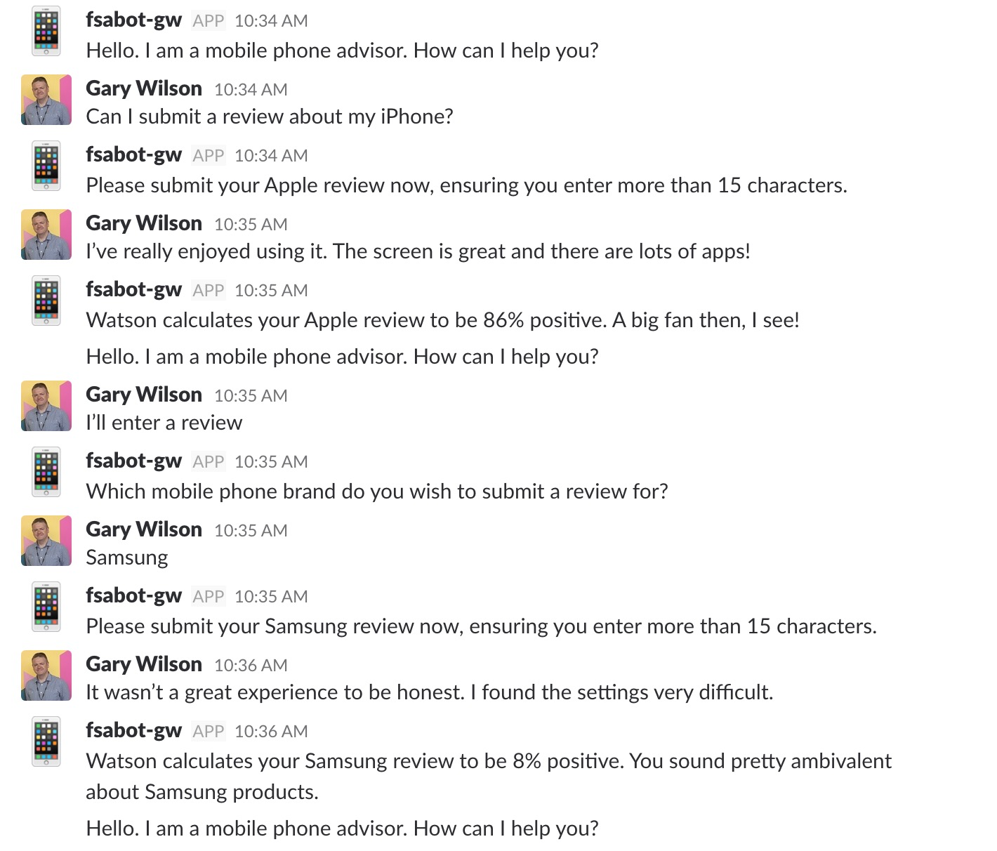
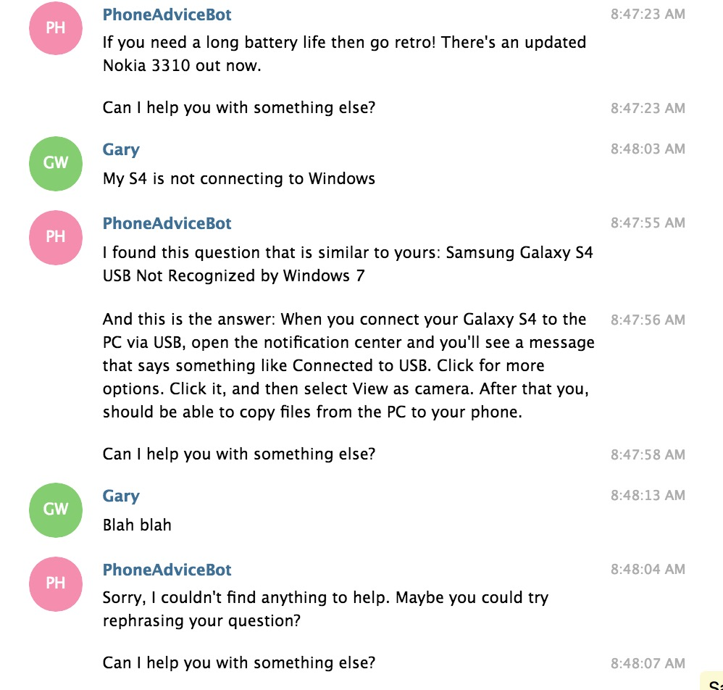
Cognitive Chatbot

Slide 8
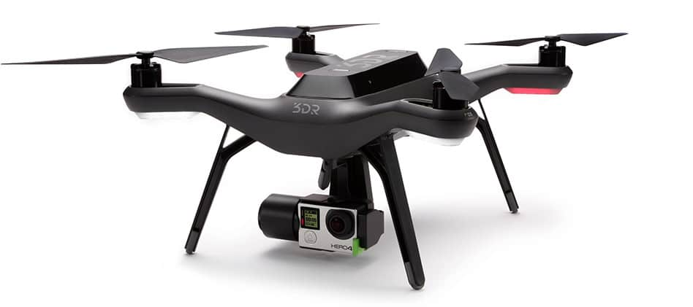
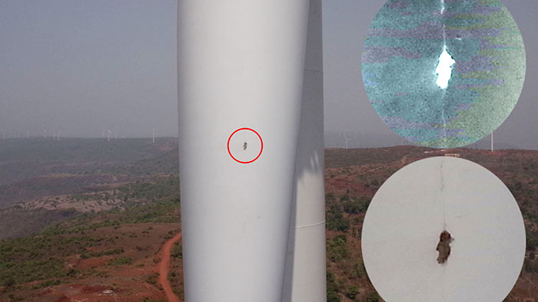
Visual Recognition
Notes:
- Cognitive Lab 2 will focus on the other prototypes mentioned
- Our second app will use Node-RED dashboards and maps, Watson Visual Recognition and IBM Cloud Object Storage to SIMULATE a drone inspection app
- The app will simulate a drone taking photos of buildings and infrastructure, and provide a CONFIDENCE level for potential FAULTS spotted using Watson VR
- This will give you a good grounding in Watson VR, and give you some ideas of how you could APPLY this type of prototype in your own context

Slide 9
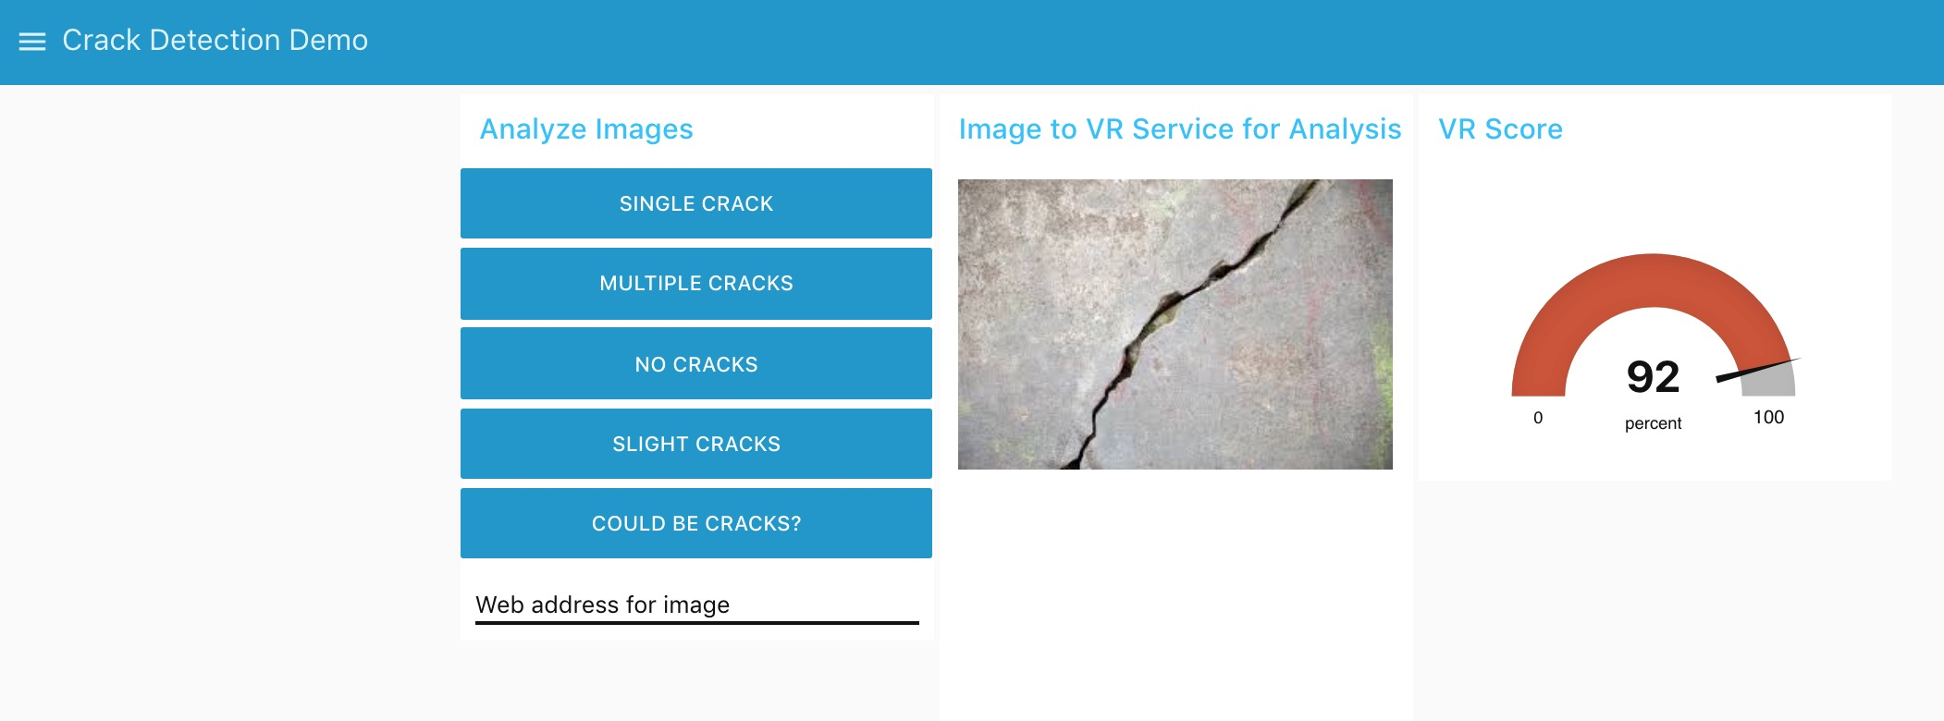
Visual Recognition

Slide 10
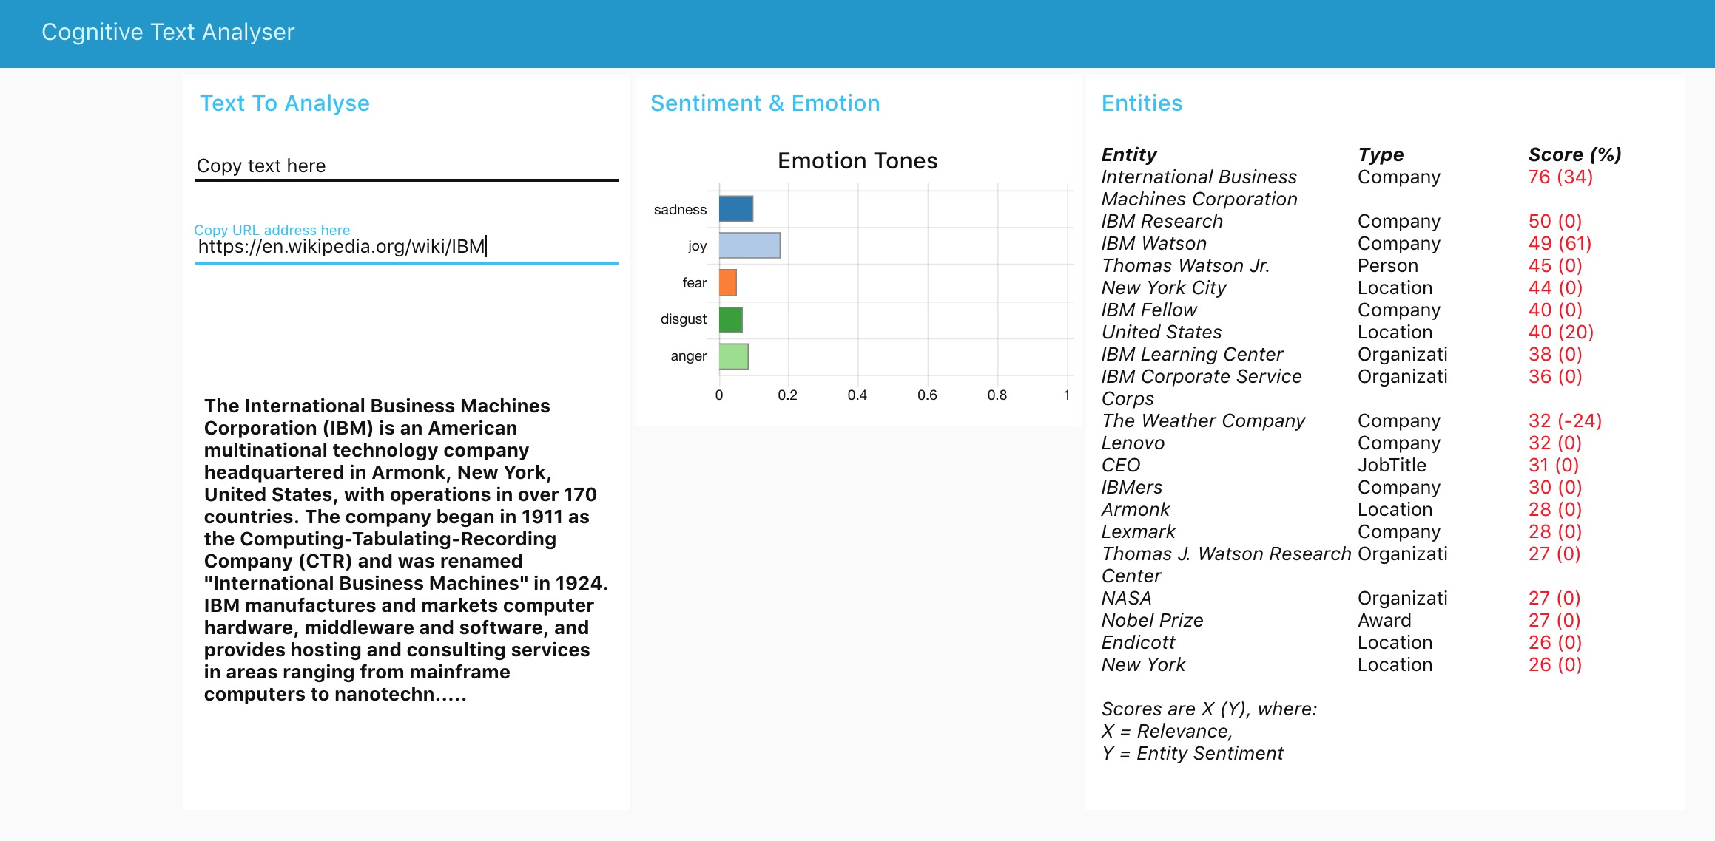
Cognitive Text Analyser
Notes:
Our third prototype will use Watson NLU to provide a cognitive text analysis of either some raw text or a web page
It uses Node-RED dashboarding to display the analysis, which includes document emotion, entities discovered and the sentiment attached to these within the document

Slide 11
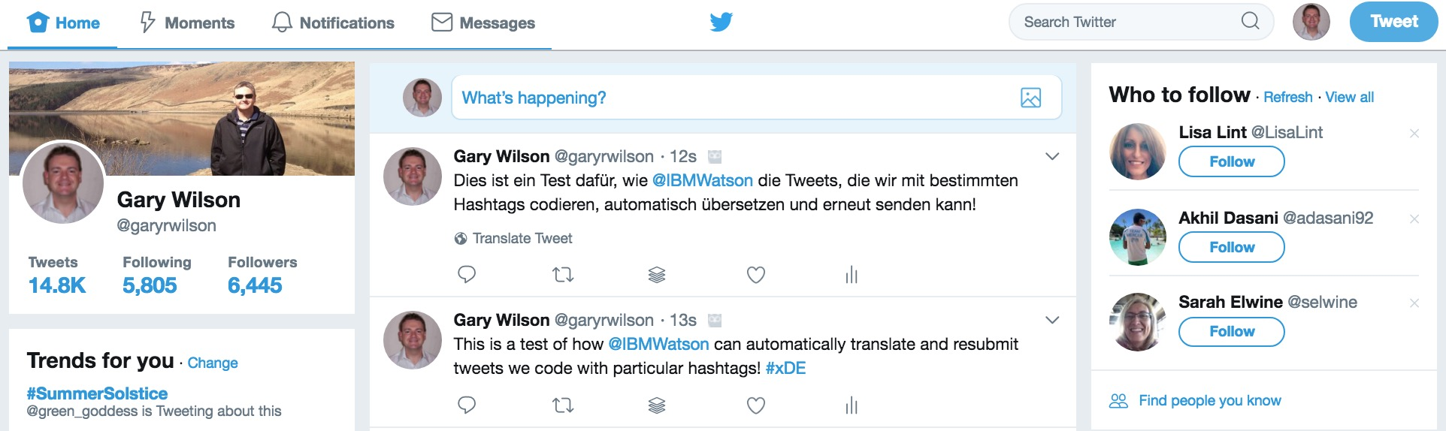
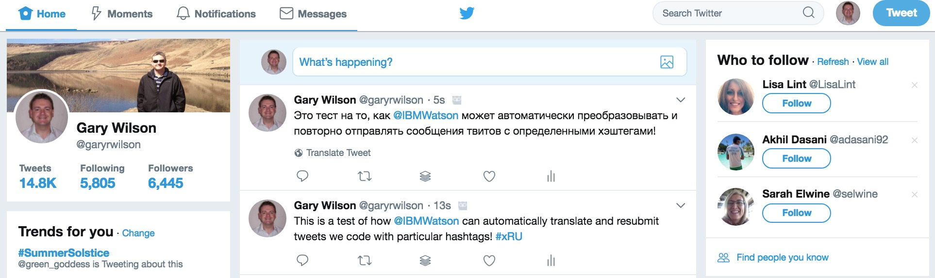
Twitter Auto-Language Translation
Notes:
Finally we have an app that uses Watson Language Translator that can automatically translate and resubmit personal tweets that have a qualifying hashtag
This could be great for global organisations wanting to get messages across to customers around the world!

Slide 12
Lab Format
Step-by-step instructions
GitHub README.md for each lab
Work at your own pace
https://github.com/garyrwilson/Watson-Cognitive-Labs

Slide 13

Cognitive Labs Gary Wilson CTO & Technical Leader, UKI Commercial Business

